Slide 1
Change Keys in heaps Fibonacci heap
Zhao Xiaobin

Slide 2
5.7 Changing keys in heaps
Additional operation
Main motivation come from interest in binominal heaps
Different : we need identify the element
We need pointer into the structure due to heap not support Find operation

Slide 3
Possible changes
In the array-based heap, the item move through the array
If we use rotation as rebalancing method on half-ordered trees, standard to different node
Even binominal heap implementation. Although that easily to change.

Slide 4
Solution
A finger points to a node that itself contains a pointer to the current node that contains the element; and the node that contains the element contains a pointer back to that indirection node. So the node can be updated.

Slide 5
For different heaps
Balanced search trees as heaps : delete followed insert O(log n) operation
Array-based heaps : also support key change in O(log n) , just moving elements up and down until heap order is restored.
Heap-ordered tree support key changes, at worst the height of the tree.

Slide 6
Leftlist heaps and skew heaps cannot get efficient key change, due to neither allow a sublinear height bound.
Binomial heap: O(log n) for decrease keys O((log n)^2) increase keys usually only use decrease keys, So binomial heaps does all usual operation in O(log n) time.

Slide 7
Fibonacci Heaps
Like a binomial heap, also a half-ordered tree.
Not necessarily of distinct size.
Each node has a integer field n→rank as well as n→state (complete or deficient) F1 for n-rank >1 or =1and n-state =complete holds n-right not null.

Slide 8
F1.1 n-state = complete then on the left path below n-right there are n-rank nodes which have n-rank-1, n-rank-2 ….. 0 in some sequence
F1.2 n-state = deficient then have n-rank -1 nodes which n-rank-2,n-rank -3……0 in some sequence

Slide 9
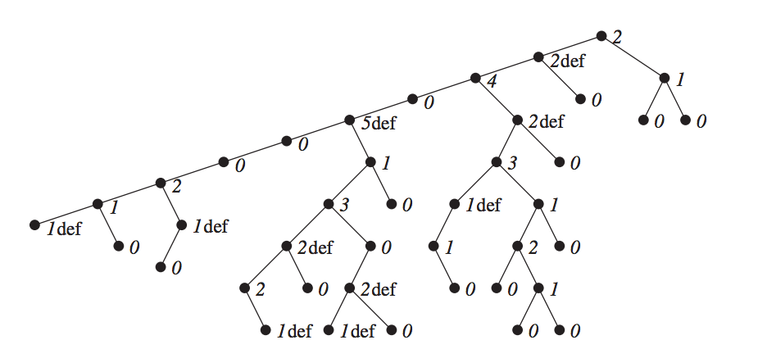
F2 for n-rank =0 or 1, n-state =deficient holds n-right = NULL

Slide 10
No deficient nodes
B1 n-rank>0, holds n-right not null. Left path below n-right there are exactly n-rank -1, n-rank-2, ….. 0 in decreasing sequence.
n-sate=complete there are at least 0, 1,2,….k-2 for rank k
f(k)=f(k-2)+f(k-3)+….f(1)+ f(0)+1
f(k-1)=f(k-3)+…..f(1)+f(0)+1

Slide 11

f(k)=f(k-1)+f(k-2)
And f(1)=f(0)=1

Slide 12
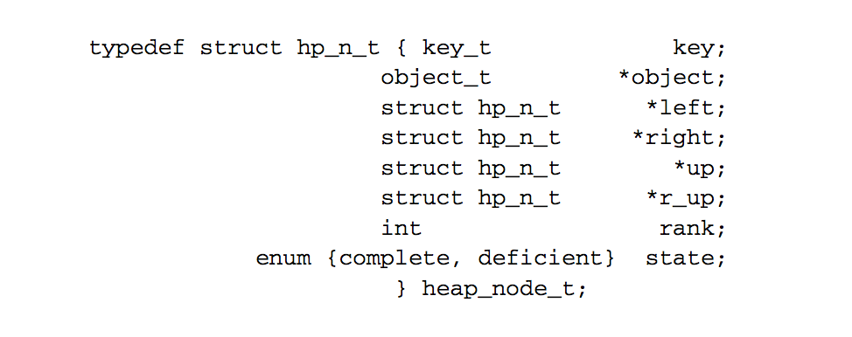

Slide 13
Find-min in O(1)time:
Maintain a pointer to the leftmost node and minimum node. Fibonacci heap is half-order tree, so minimum element occurs somewhere on the leftmost path
Insert operation O(1)time:
Place a new node with rank 0 on the top of the leftmost, compare with previous minimum.

Slide 14
Decrease key
1.decrease key in n, if new key smaller than minimum, adjust min pointer.
2. if n->r_up = NULL, we are finished.
3. Else half-order might be violated in n->r_up and some nodes above. u=n->r_up, unlink n from left to n->back. Place n on the left path.
4. F1 property violated
4.1 if u->r_up =NULL, decrease u->rank by 1

Slide 15
4.2 Else if u->state =complete, then set u->state =deficient
4.3 Else u->state =deficient, decrease u->rank by 2, or 1 if it becomes negative. Set u->state to complete.
unlink u from left path to it belongs. Place u to leftmost path, set u to u->r_up and repeat 4.

Slide 16
Unlinking process is O(1)
each deficient node means one decrease operation. n decrease operation start with a deficient nodes end with b deficient nodes takes O(n+a-b)time and place O(n+a-b)nodes on leftmost path.
Time complexity: amortized O(1)

Slide 17
Delete_min
1.Unlink current min node n, place nodes on the left path of n->right on top of leftmost path and delete n.
2. Create an array of nodes pointers size O(logn) with entry of each possible rank.
3. Go down the leftmost path, Set n to the next node on leftmost path.
4. Set minimum pointer and leftend pointer.

Slide 18
Step 1 O(log n)
Step 2 O(1)
Step 3 up to the length of leftmost path O(L)
Step 4 size of array O(log n)
Delete_min: O(log n)

Slide 19
Effective but complicate.
Operation
Linked List
Binary Heap
Binomial Heap
Fibonacci Heap †
Relaxed Heap
make-heap
1
1
1
1
1
is-empty
1
1
1
1
1
insert
1
log n
log n
1
1
delete-min
n
log n
log n
log n
log n
decrease-key
n
log n
log n
1
1
delete
n
log n
log n
log n
log n
union
1
n
log n
1
1
find-min
n
1
log n
1
1
n = number of elements in priority queue
† amortized

